Slide 1
EMS Protocol Analysis
A cross-agency comparative review for Washoe County Health District
Notes:
This template can be used as a starter file to give updates for project milestones.
Sections
Right-click on a slide to add sections. Sections can help to organize your slides or facilitate collaboration between multiple authors.
Notes
Use the Notes section for delivery notes or to provide additional details for the audience. View these notes in Presentation View during your presentation.
Keep in mind the font size (important for accessibility, visibility, videotaping, and online production)
Coordinated colors
Pay particular attention to the graphs, charts, and text boxes.
Consider that attendees will print in black and white or grayscale. Run a test print to make sure your colors work when printed in pure black and white and grayscale.
Graphics, tables, and graphs
Keep it simple: If possible, use consistent, non-distracting styles and colors.
Label all graphs and tables.

Slide 2
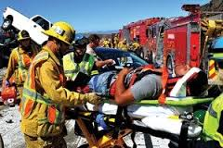
Essential Background
Issue of varying EMS protocols in multiagency environment in Washoe County
Standardization of Care
Facilitate interagency operations in era of MCI events and threat of terrorism
Initial element of the regional five year plan
Notes:
What is the project about?
Define the goal of this project
Is it similar to projects in the past or is it a new effort?
Define the scope of this project
Is it an independent project or is it related to other projects?
* Note that this slide is not necessary for weekly status meetings

Slide 3
EMS Consultant Group
Private Company out of Philadelphia Region
Comprised of EMS Professionals including
Board Certified Emergency Physicians
Critical Care Paramedics
EMS Educators

Slide 4
Individuals Involved in Current Review Project
Jordan B Barnett, MD MBA FACEP FAAEM
Eric A Rosen, BAS MA(c), NRP, FP-C, CCP-C
Kenneth N Davis Jr, EMT-I M.ed

Slide 5
Jordan Barnett, MD MBA FACEP FAAEM
Board Certified Emergency medicine Physician
Forer New York City Emergency Medicine Service Specialist with New York City EMS
Former Firefighter
Residency Trained Thomas Jefferson University Hospital
Executive MBA Rutgers Business School
Dean of Department of Labor’s Philadelphia Job Corp EMS Program
Examiner Pennsylvania National Registry Paramedic Examination
Medical Command Director for numerous agencies and hospitals

Slide 6
Eric Rosen, BAS, MA( c ), NRP, FP-C, CCP-C
Seasoned BCLS, ACLS, PALS, ITLS instructor
Experienced in 911 systems and tertiary level critical care transportation
ALS Coordinator for numerous emerging small and established EMS agencies
Certified Flight Paramedic
Certified Critical Care paramedic
Critical Care Paramedic with Temple Health System
Clinical Educator in critical care transport with Temple as well as OSHA trainer

Slide 7
Kenneth N Davis Jr, EMT-I M.ed
Established the EMT Program with Department of Labor’s Philadelphia Job Corp Program
EMS education for University of Pennsylvania
EMS Education at Villanova University
Programs by Mr. Davis highlighted in the Commonwealth of Pennsylvania as Model for other programs
HAZMAT and recertification trainer

Slide 8
EMS Consultant Group Involvement
Request by Washoe County Health Department for unbiased review of agency policies
No commercial or financial bias
Intent is a fair and balanced review of guidelines
Intent is to make recommendations based on current care guidelines
No intent to rewrite regional protocols
We respect the requirement for local agencies to formulate finalized regional protocols specific to their situation
Notes:
* If any of these issues caused a schedule delay or need to be discussed further, include details in next slide. In point number 6 – do we?

Slide 9
For Process to be Successful
Imperative to have agency “buy-in”
With all agencies having buy-in, model care for other regions to follow
Can create a model where receiving hospitals can augment further prehospital care by understanding and educating based on clear expectations.
Model assists in promoting interagency interoperability
All stake holders need to be involved

Slide 10
Process of Review
Facilitated by Washoe County Health District
Combined PDF produced containing protocols for all participating agencies
Rational for the above process
Variable Title Headings
Indexes within Indexes
Table of Contents Issues
Notes:
Duplicate this slide as necessary if there is more than one issue.
This and related slides can be moved to the appendix or hidden if necessary.

Slide 11
Process
Protocol topic Identified
Best of Protocols Extracted
Similarities / identified
Recommendations made
Comparison to EM literature, ACLS/ATLS/ PALS protocols
Notes:
The following slides show several examples of timelines using SmartArt graphics.
Include a timeline for the project, clearly marking milestones, important dates, and highlight where the project is now.

Slide 12
No intent to single out any individual agency Issues identified will be discussed as open forum Use of Protocol Analysis necessitates cross referencing combined protocol PDF from Washoe County Health District This was a learning process for us too!

Slide 13
Method of Using the Protocol Review
Cross Reference Protocol in Analysis
Open Combined PDF From Washoe
Recommendation

Slide 14
Considerations in Formulating Countywide Protocols
Standardized Format
Color Coding For Varying Levels of Prehospital Care
Arrangements made for protocols that update fairly frequently (ACLS, PALS)
Electronic AND Printed Versions
Input from prehospital providers in conjunction with medical directors
Regular Future meetings – a “Living Document”

Slide 15
Suggested Format for Countywide Protocols
Protocols should be written in a “singular format” – example follows
Overview of illness, with guidelines for HPI, Signs and Symptoms, and Considerations
Any algorithms used should have appropriate labeling for level of provider
Use of color coding to assist providers in defining level of care that pertains to them
There are many examples of “singular” formatted protocols – each have their pros and cons

Slide 16
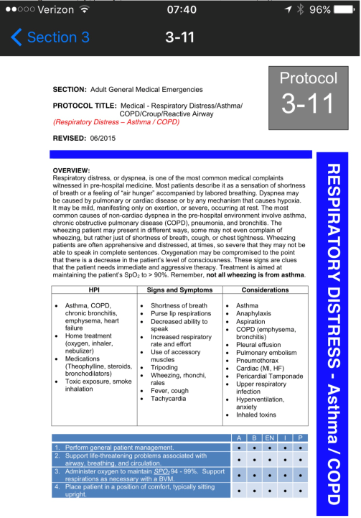
Notes:
Modify with better graphic

Slide 17
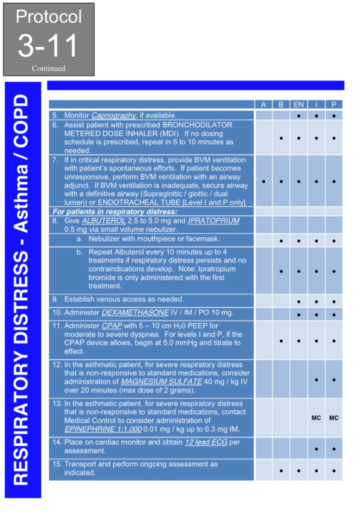

Slide 18
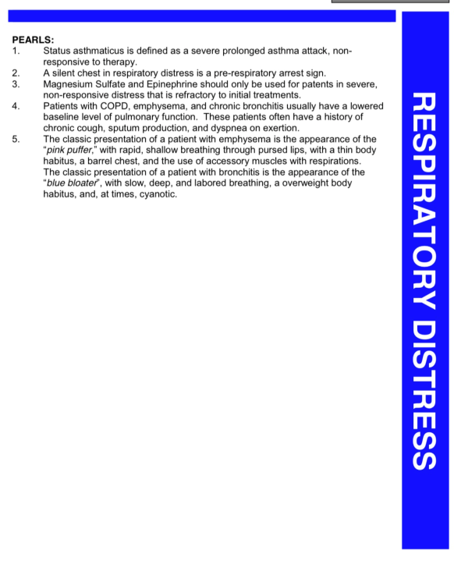

Slide 19
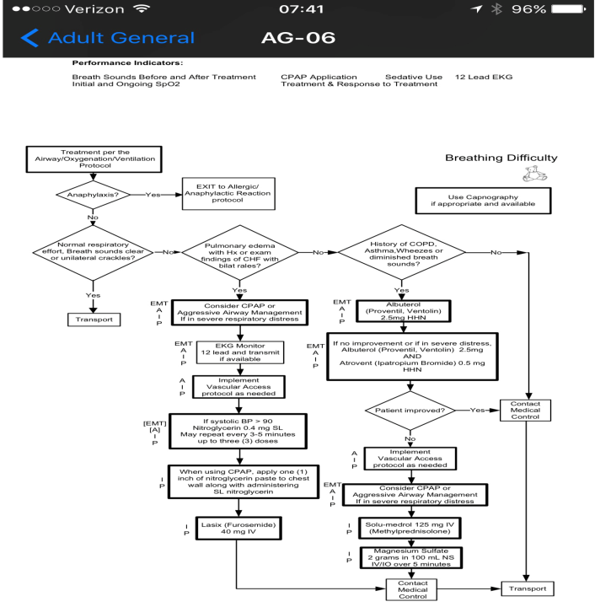

Slide 20
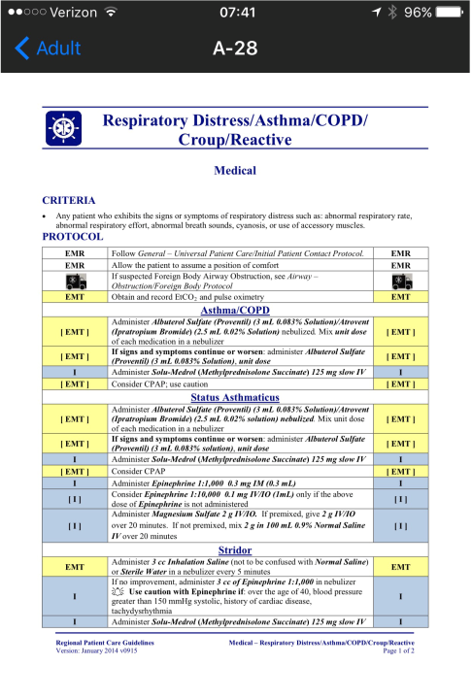

Slide 21
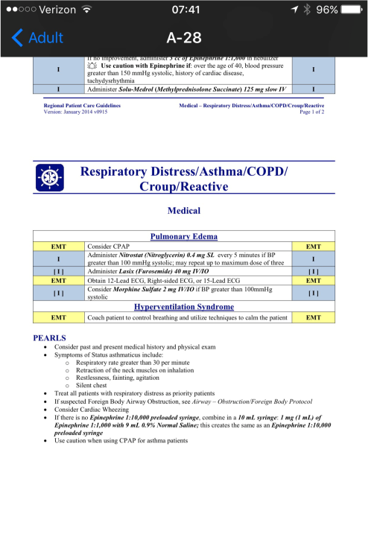

Slide 22
Clark County EMS System has a Unified Protocols!

Slide 23
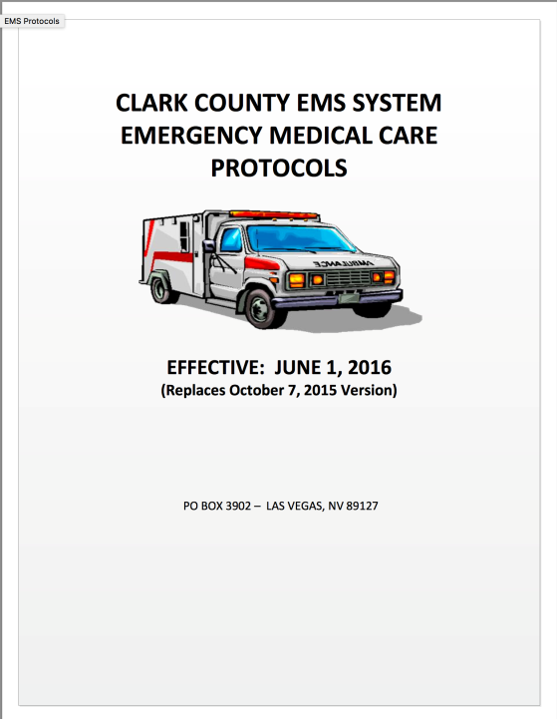

Slide 24
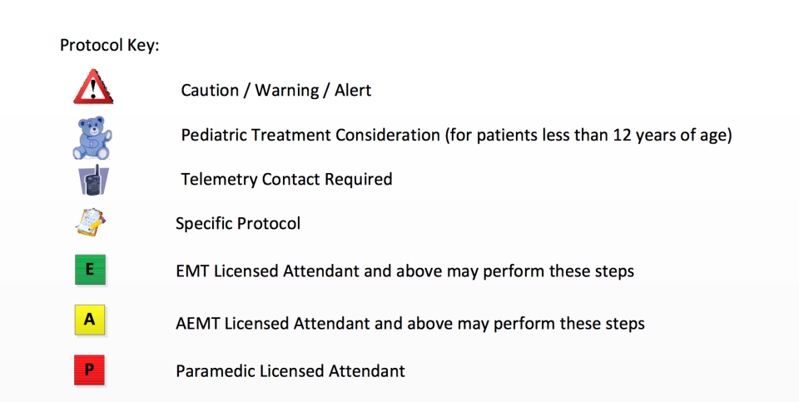

Slide 25
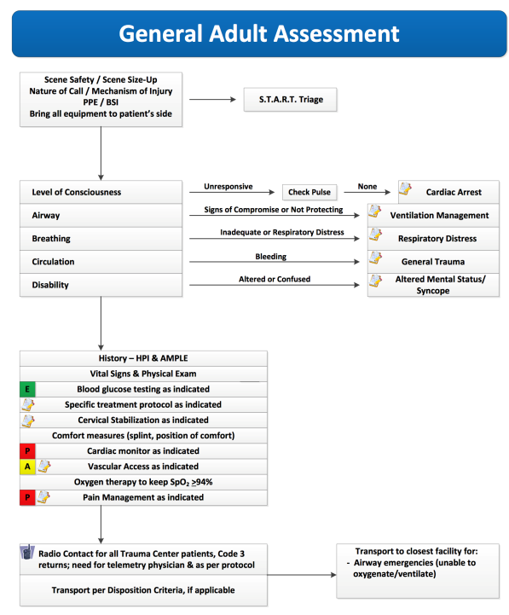

Slide 26
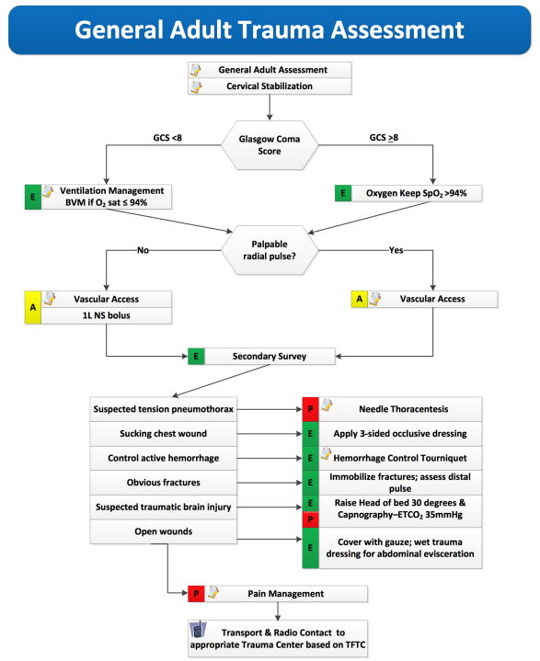

Slide 27
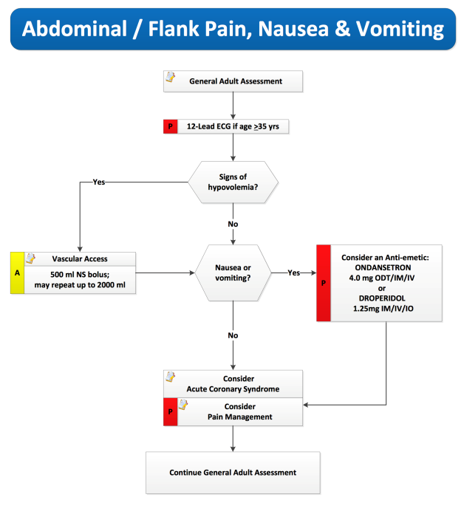

Slide 28
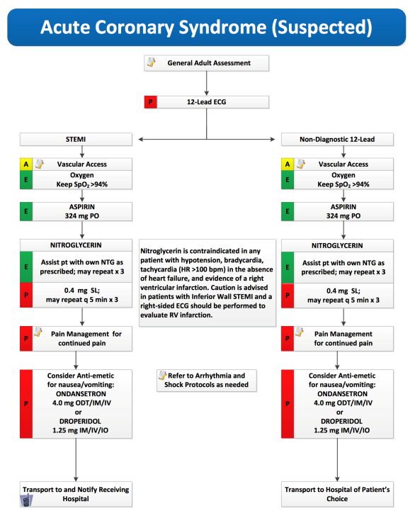

Slide 29
www.EMSProtocols.org Many Examples of Multilevel of Care Unified Protocols

Slide 30
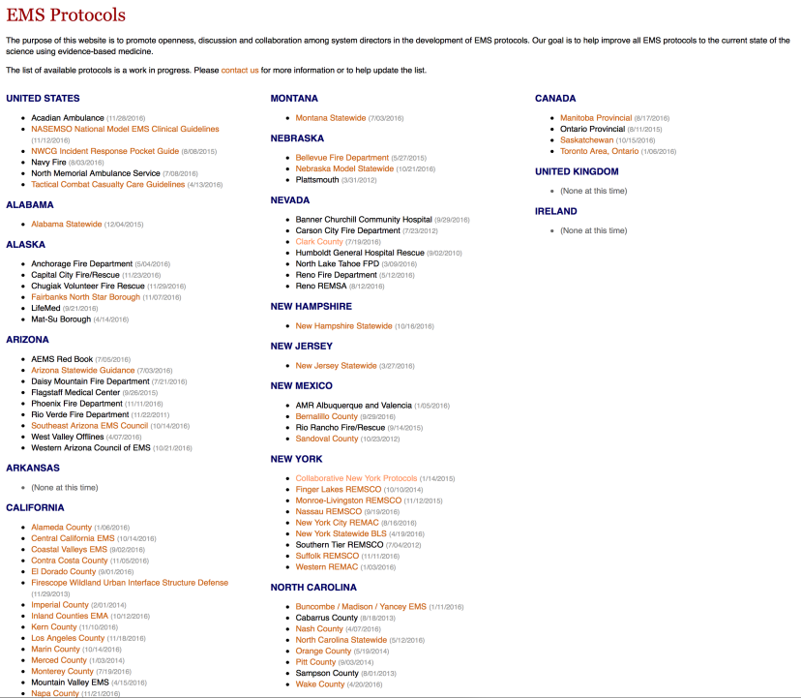

Slide 31
Collaborative New York Protocol example from preceding website

Slide 32
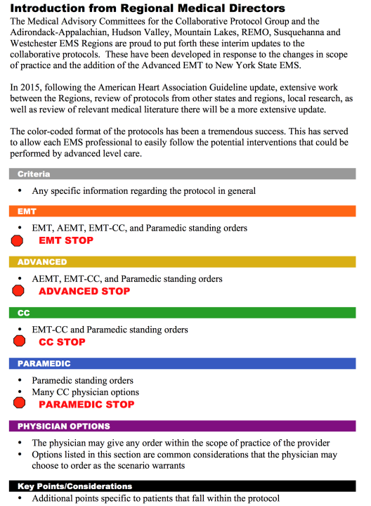

Slide 33
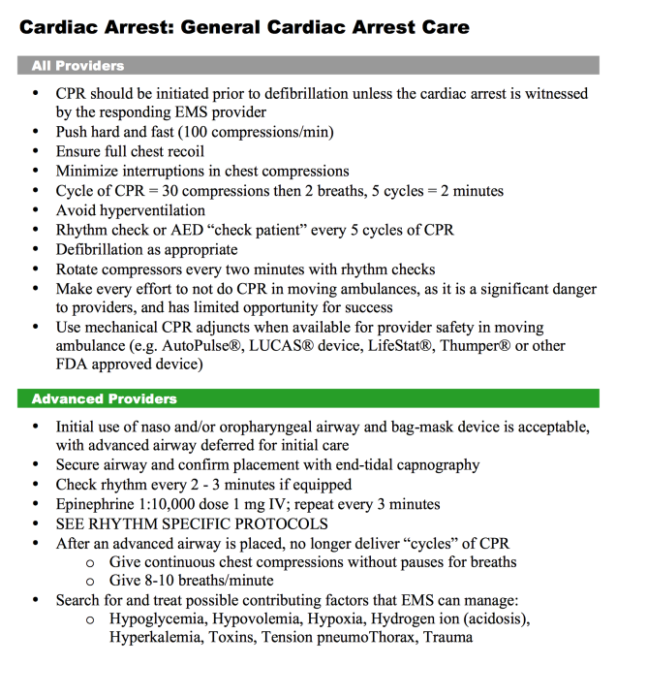

Slide 34
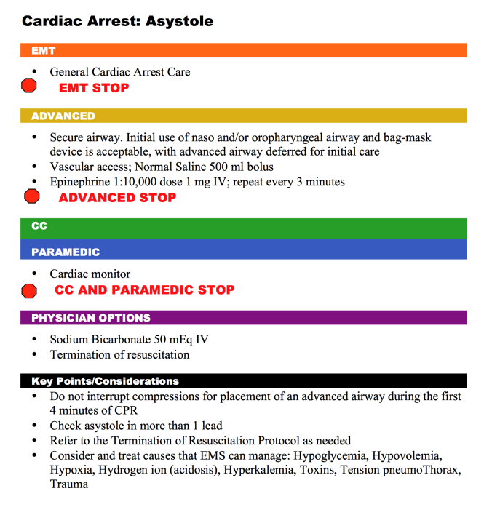

Slide 35
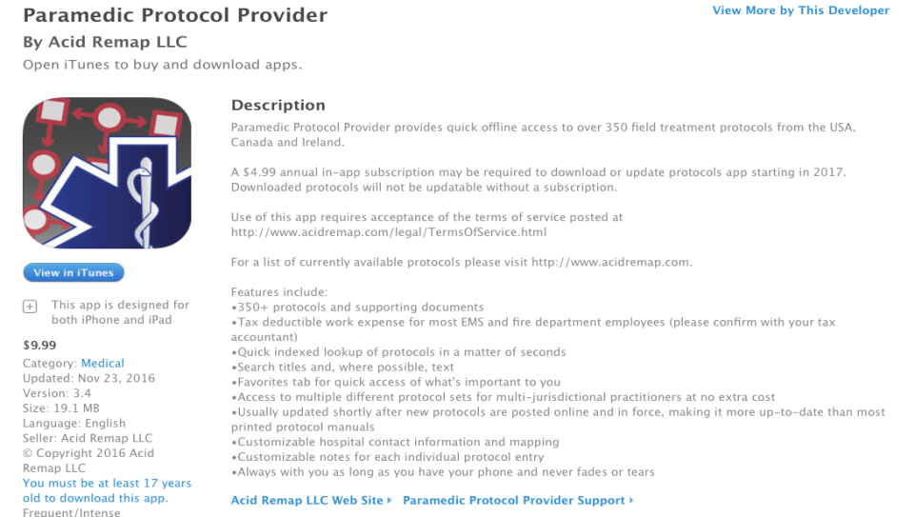
Electronic Version of Countywide Protocols? There is an App for that!

Slide 36
Protocols for multiple counties across the country are already indexed in this app! REMSA and Reno Fire Department, as well as Clark County protocols are already included!

Slide 37
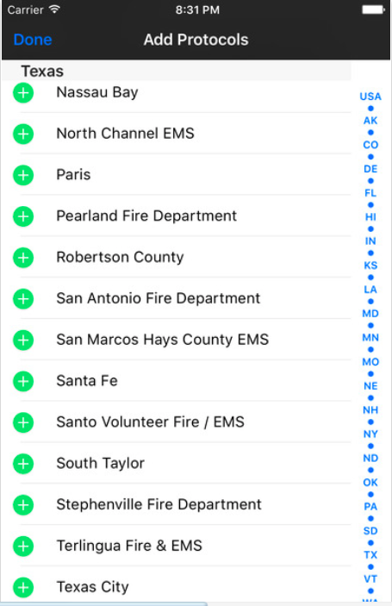

Slide 38
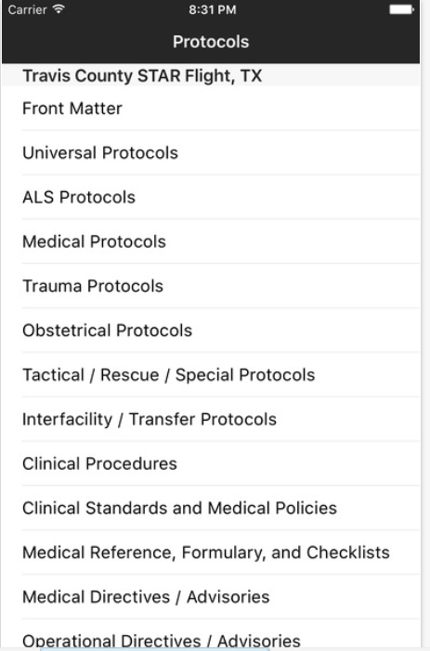

Slide 39
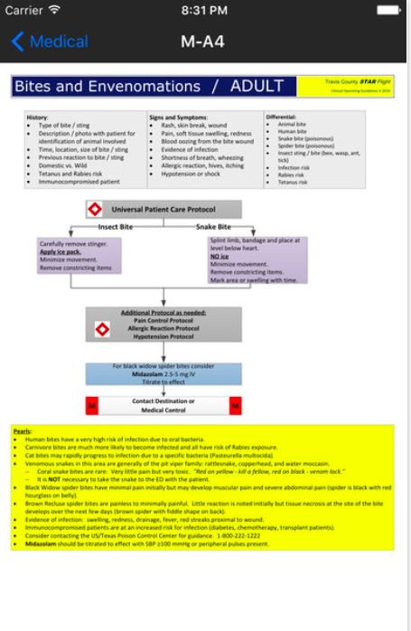

Slide 40
Any Countywide Protocols developed can be uploaded and indexed within this app! “Why Reinvent the Wheel?”

Slide 41
PRO/CON of Washoe County Using this app for Protocol Distribution?
PRO
CON
Developer Does Indexing
No cost or time spent in developing an app
Android and iPhone versions already exist
Developer takes the responsibility of indexing
Developer Maps out the protocols from any submitted PDF
Current Fixed cost for app
No control over formatting of protocols
What if the developer stops updates?
What if the developer looses interest in maintaining the program?
$10 upfront and future variable cost for every EMT, EMT-I, Paramedic in Washoe County. Same funds could be used upfront as a fixed cost for ”in-house” app development
Malware risk with externally sourced app

Slide 42
Rationale for Provider input in Protocol Development
Patient
EMTs
EMT-I
Paramedics
Medical Director
Receiving Hospital
Notes:
What are the dependencies that affect the timeline, cost, and output of this project?

Slide 43
Questions / Comments
Regarding discussion so far……
Notes:
Prepare slides for the appendix in the event that more details or supplemental slides are needed. The appendix is also useful if the presentation is distributed later.

Slide 44
OK, here we go…

Slide 45
Some Protocols for Consideration as Group Review
Child and Elder Abuse
Poisoning / Overdose
Airway Management
Respiratory Distress
Specific Drug Issues
Chest Trauma
Shock Protocols
Notes:
I’m curious, why these particular ones?

Slide 46
Child and Elder Abuse
Potential Points of Consideration:
In most states there is a mandatory reporting requirement
A more aggressive stance possibly required for EMS
Endangered / neglected adults should be reported to social services agencies
Guidance and training in recognition is important

Slide 47
Poisoning and Overdose
Potential Points of Consideration:
Removal of Activated Charcoal
Increasing and emphasizing Glucagon over other agents in hypotension associated with Beta Blockers and Calcium Channel Blockers
Specifying Naloxone be titrated to return of adequate respirations
Removal of Hyperventilation for TCA OD
The ability to consult Poison Control

Slide 48
Airway Management Issues
Points of Potential Consideration:
Video Laryngoscopy
The role of the Bougie
The roles of digital and nasotracheal intubation
Guidance on field use of paralytics and sedation assisted intubation– when to stay, when to treat on the move, when not to use
The role of surgical airways; percutaneous, needle and surgical

Slide 49
Respiratory Distress
Potential Points of Consideration:
Minimal use of diuretics
Maximize patient positioning
Maximize nebulizer therapy – continuous Albuterol with some Ipratropium
Add better guidance for therapy with Magnesium Sulfate
Add better guidance for therapy with CPAP
Use of Solumedrol

Slide 50
Drug Issues
Potential Points of Consideration:
Lidocaine
Prophylaxis in AMI
“Malignant PVCs”
Heparin
Prehospital Loading
Gravity infusion
Labetalol
Hypertensive crisis
Metoprolol
AMI

Slide 51
Chest Trauma
Potential Points of Consideration:
Early intubation and indications for the procedure
The use of prehospital pericardialcentesis

Slide 52
Shock Protocol Issues
Potential Points of Consideration:
The use of push dose pressor
Fluid management guidelines in sepsis
Evidence based pressor selection in sepsis
Permissive hypotension in hemorrhagic shock
Use of TXA

Slide 53
Summary
Via Group Review, it should be obvious that the best of each agency’s protocols can be used to create an excellent countywide protocol set
Many agencies here found items excluded in their individual protocols – “oversights”
Our Recommendations are for consideration and guidance in protocol development
The more “buy-in,” the better the final product
The more “buy-in,” the faster the process

